Slide 1

STOP! You’re automating too much!
(and other tales from the field)
Notes:
There is a lot here for...
devs, qa, ba and project leadership
Meant to wet your whistle.
“WHAT IS YOUR PAIN?”

Slide 2
My name is Shawn and I’m a software developer
Notes:
I used to be a tester in my first job.
I work for Centric Consulting
Why does a developer care about our functional test automation suite?

Slide 3
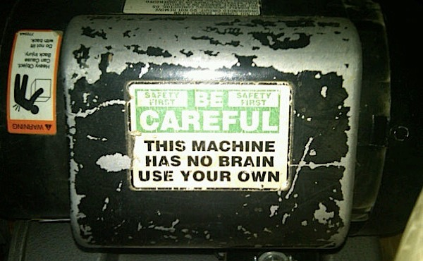
Notes:
Standard disclaimer, your mileage may vary.
These are just my own experiences and conclusions. Your ideas are probably better than mine.
Your process, team, backlog, organization make a difference.

Slide 4
Why is test automation a good idea?

Slide 5
Our existences are about precise communication...and communication is about feedback loops
Notes:
Which means feedback is important

Slide 6
Our existences are about precise communication...and communication is about feedback loops
Notes:
Which means feedback is important

Slide 7
Why Acceptance Test Automation?
Implementing changes more efficiently
Shortened feedback loop
Higher product quality
Less rework
Better work alignment to priority
Helps make systems easier to modify

Slide 8
Why Acceptance Test Automation?
Implementing changes more efficiently
Shortened feedback loop
Higher product quality
Less rework
Better work alignment to priority
Helps make systems easier to modify

Slide 9
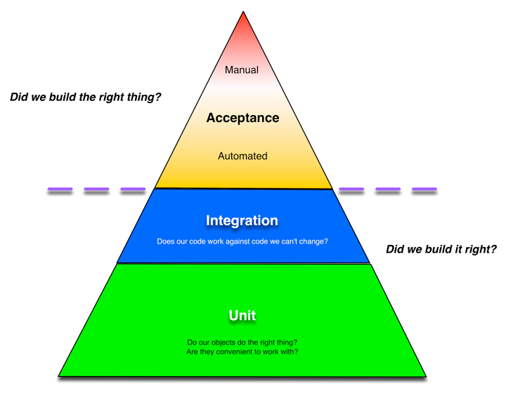

Slide 10
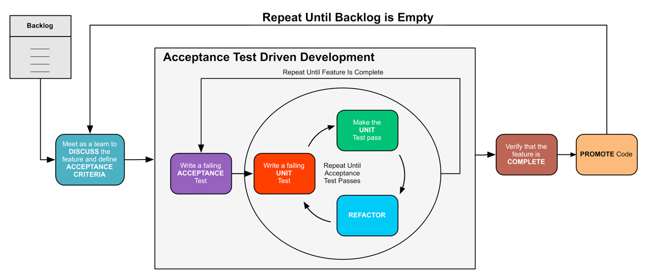
Part of the process…
Notes:
BDD is how we encode the failing ACCEPTANCE test

Slide 11
Can my team benefit?
We can improve design going forward
The goal is writing working code/providing value

Slide 12
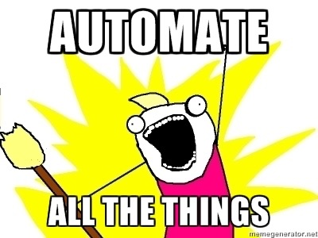

Slide 13
How do I get started?

Slide 14
How do I get started?
Test KEY use cases
Test defects
Test new features

Slide 15
What should I automate?

Slide 16
What should I automate?
You are testing the behavior of your system
What do you need to test to determine if your system is behaving?
Regression is a side-effect
Notes:
Talk to your customer

Slide 17
Don’t forget your testing triangle

Slide 18
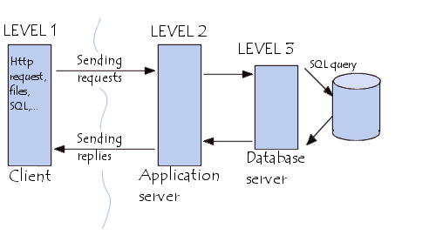

Deliberately test your system at the physical boundaries
Know what your system does and how it works
Collaborate! Collaborate! collaborate!
Notes:
remember your testing triangle

Slide 19
Where does automation fit in with our process?

Slide 20
WWTDDD
We define our Acceptance Criteria
AND
Encode them as Acceptance Tests
Notes:
When we work for a time, we’ll see if this is practical at scale later on in the talk…

Slide 21
What solution and architectural dependencies am I driving?

Slide 22

Poorly designed or implemented systems tend to be hard to test
Code under test might need to be refactored
Test suite could be inefficient

Slide 23
Case Study in Pain
Huge Automated Functional Test Run
5500+ Scenarios
550+ Hours to Execute

Slide 24
Case Study in Pain
Huge Automated Functional Test Run
5500+ Scenarios
550+ Hours to Execute
Notes:
THIS IS WHY I CAME UP WITH THE TITLE FOR THIS TALK

Slide 25

Automated Functional Test Running Infrastructure
Notes:
This is our test running environment needed to get the test run down to 12 hours.

Slide 26
1 Team
1.5 Years
$1,000,000

Slide 27
Test code IS code
Notes:
It must be often tested and Maintained.
It requires similar software development disciplines.

Slide 28
Testing takes time and resources and requires a skill-set you might not have yet.

Slide 29
How will I run my tests?

Slide 30





How will I run my tests?

Slide 31
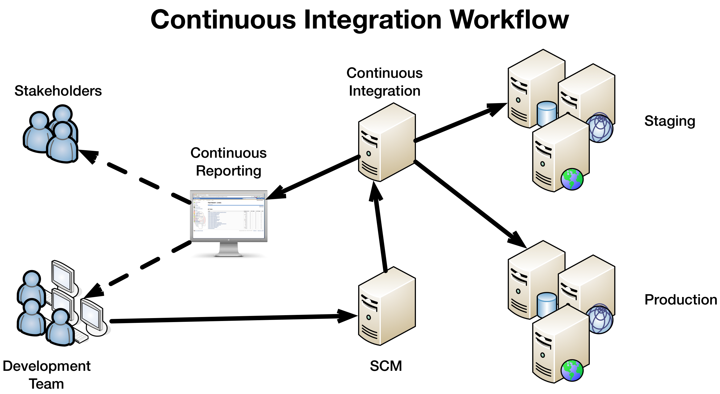

Slide 32
What do I do with all of the data?

Slide 33
What do I do with all of the data?
Test automation generates a ton of data…not all good
Need a way to store, filter and make visible

Slide 34
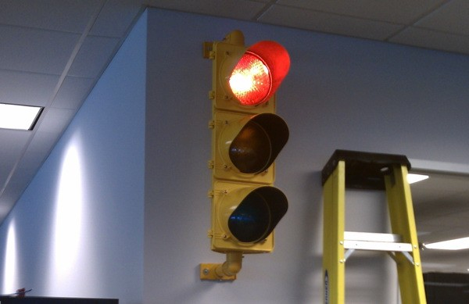
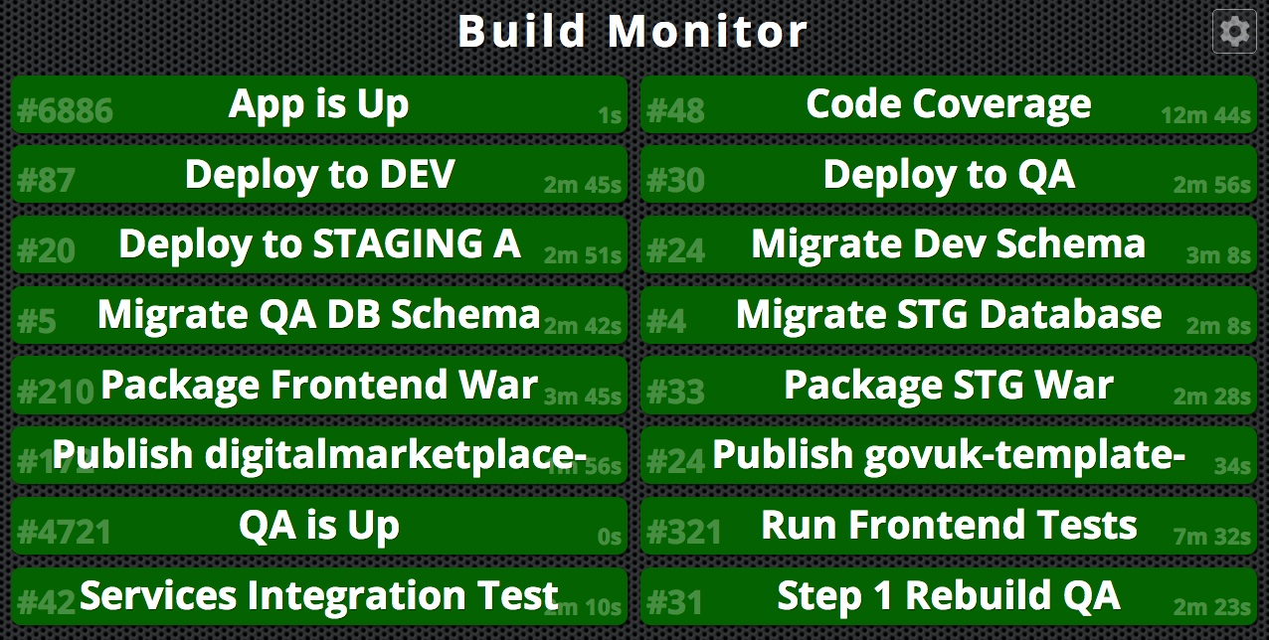
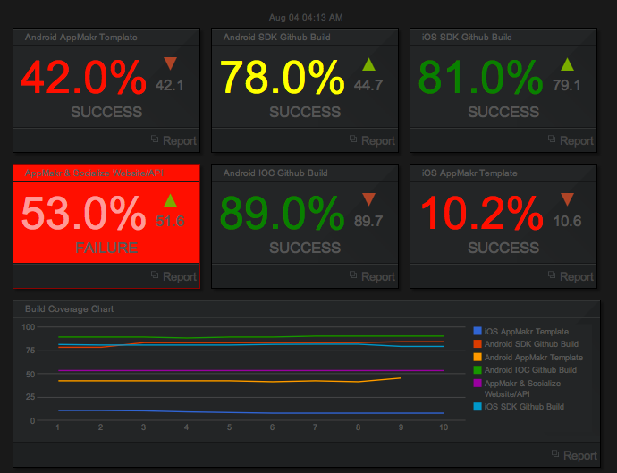
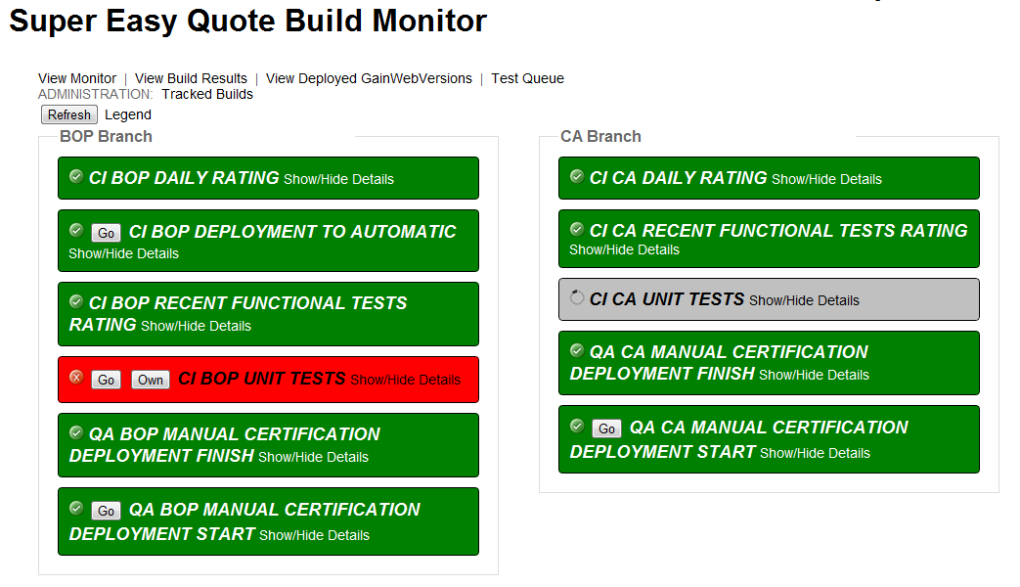

Slide 35
Do I always run ALL of my tests?

Slide 36
Run subset of all automation
DEVELOPMENT
Merge
Run entire suite
MAINLINE
Merge
PRODUCTION
Run smoke tests

Slide 37
Do I need to keep my tests forever?

Slide 38
ATDD tells us that you do…
Notes:
BDD is how we encode the failing ACCEPTANCE test

Slide 39
Practically, some tests are better for development than for regression

Slide 40
How will I know if I’m doing a good job?

Slide 41
Understand your goals

Slide 42
What does success mean in your environment?

Slide 43
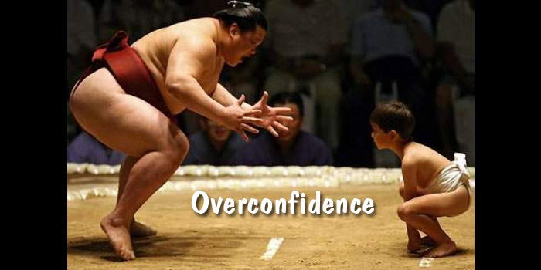
Notes:
beware of overconfidence in your test suite

Slide 44
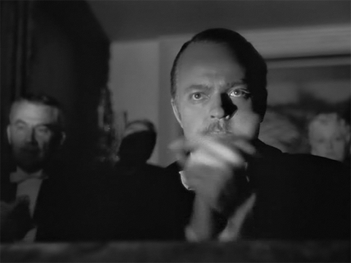
That’s all…

Slide 45
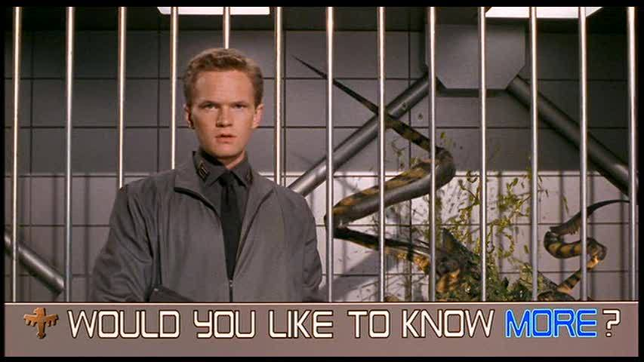

Slide 46
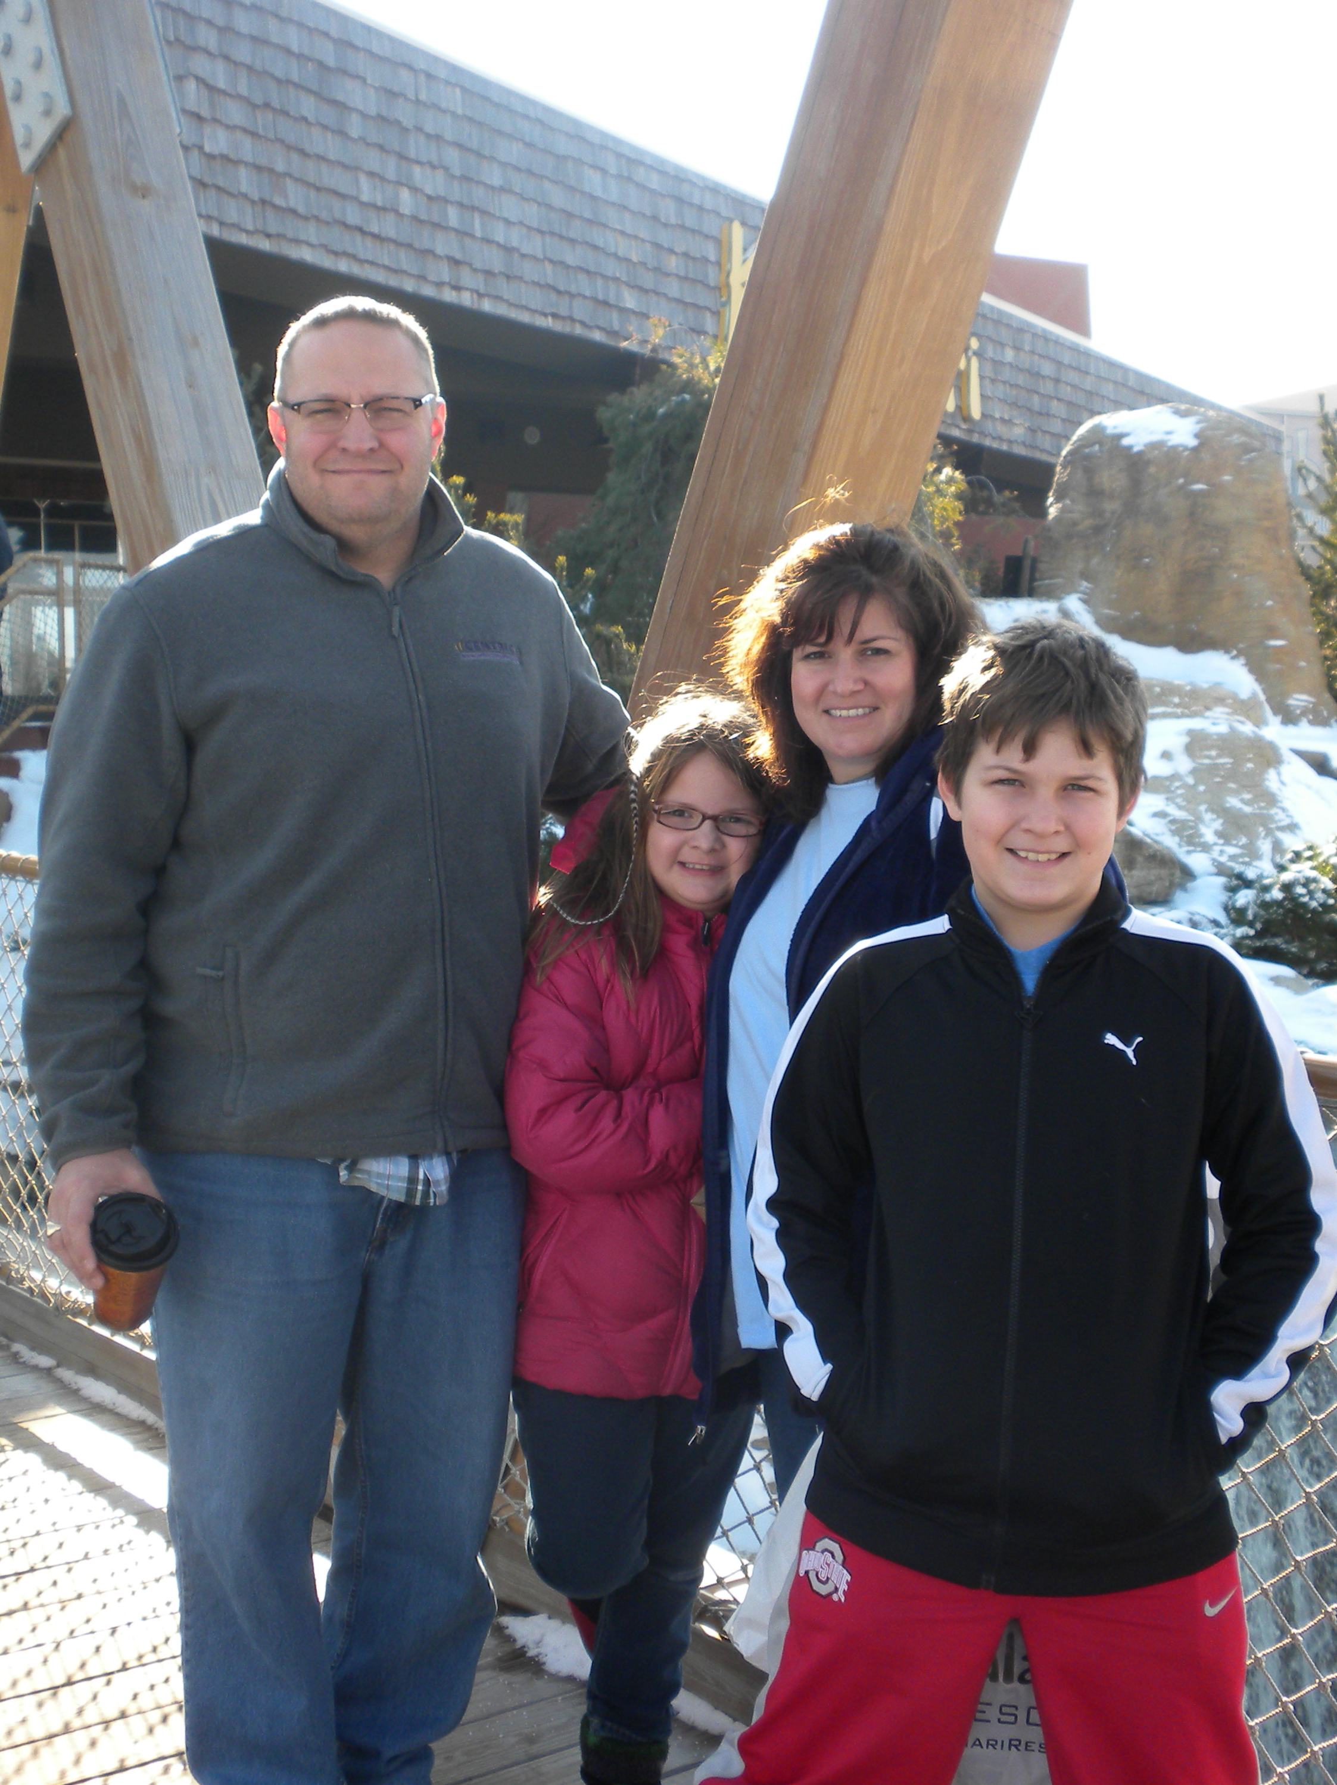
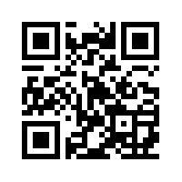
Shawn Wallace
Work: shawn.wallace@centricconsulting.com
Twitter: @ShawnWallace
Blog: blog.shawnewallace.com
http://www.about.me/shawnwallace

Slide 47
Q&A
For more information...
This Presentation on GitHub
https://github.com/shawnewallace/testing_too_much_presentation
cukes.info
Gojko Adzic
cuke4ninja.com
Specification by Example
https://github.com/aslakhellesoy/cucumber/wiki
http://groups.google.com/group/cukes
http://www.cheezyworld.com
The Cucumber Book, Matt Wayne, Aslak Hellesøy: http://pragprog.com/book/hwcuc/the-cucumber-book
The Rspec Book, David Chelimsky: http://www.pragprog.com/titles/achbd/the-rspec-book

